Slide 1
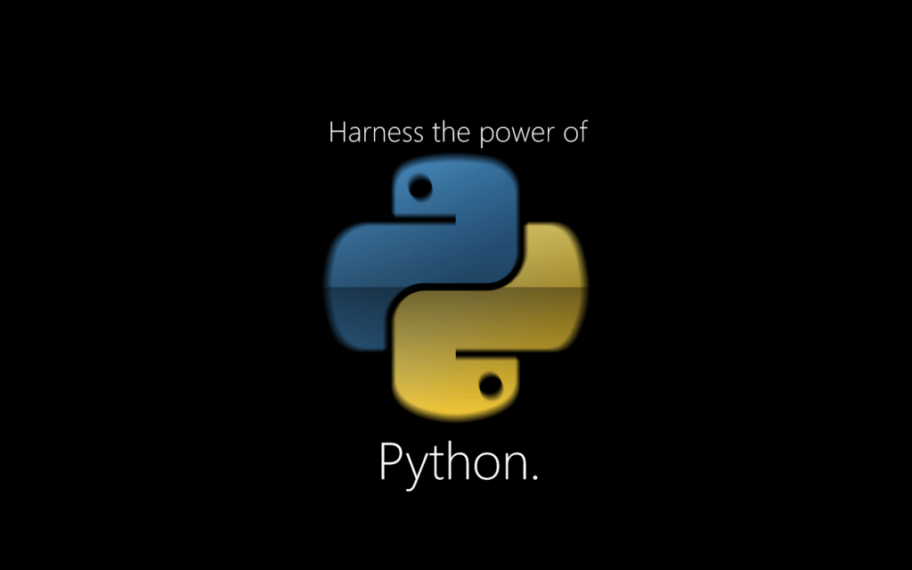
Python

Slide 2

What is Python ?
Open Source
Programming Language and Scripting Language
OOPS
Easy to Use
Easy to Learn (33 Keywords)
Fast
Latest version : 3.7.3

Slide 3
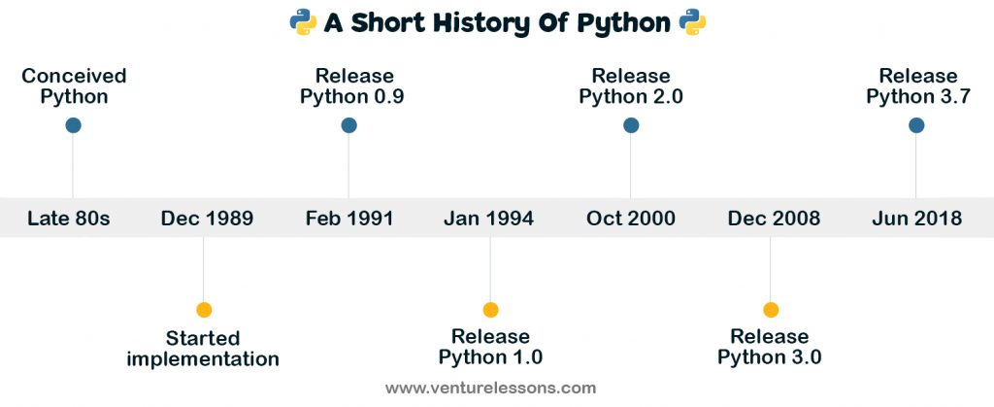
Python History

Slide 4
Python Use-cases
Automating Daily Tasks
Web Development
Cyber Security :Penetration Testing, Exploits, Vulnerability Testing
Artificial Intelligence : Machine Learning , Deep Learning , Data Science
Computer Graphics, Games
IOT
Web Scraping
Big Data

Slide 5
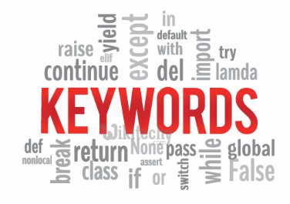
Why Now Python
Network Devices , security Devices.
Automation
Will keep updated.
Lot of IOT Devices.
Even School Kids learning Python as Subject.

Slide 6
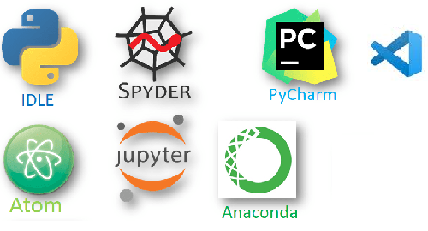
Integrated Development Environment (IDE)
Offline
Anaconda : Collection
JupyterLab
Jupyter Notebook
Spyder
Pycharm
VS Code
Online:
Kaggle
Google Colab

Slide 7
Stay Tuned for next videos…..
Thanks !!!

